Slide 1

Scrum
Framework
MN. Sihanas
BCAS Campus Kalmunai,
School of Computing. Batch 22.

Slide 2


Introduction to Scrum
What is Scrum?
Why Scrum?
A framework for agile project management.
Enhances collaboration, flexibility and accountability.
Focuses on delivering high-value products through iterative development.
Notes:
What is Scrum?
"Scrum is an Agile framework that helps teams work together to develop and deliver high-quality products. It promotes iterative progress through short cycles called sprints, allowing teams to adapt to changing requirements and feedback.“
Why Scrum?
"The Scrum framework enhances collaboration and accountability among team members. It allows teams to deliver value quickly, respond to changes, and continuously improve their processes and products."

Slide 3



Key Roles in Scrum
Composed of three main roles
1. Product Owner
2. Scrum Master
3. Development Team
Represents stakeholders.
Facilitates the Scrum process.
Cross-functional group that does the work.
Responsible for defining and prioritizing the product backlog.
Removes obstacles and ensures adherence to Scrum principles.
Self-organizing and responsible for delivering increments of the product.
Notes:
Scrum Team:
"The Scrum Team consists of three key roles: the Product Owner, the Scrum Master, and the Development Team.“
Product Owner:
"The Product Owner is responsible for defining the product vision and managing the product backlog. They prioritize features based on stakeholder needs and ensure that the team is working on the most valuable tasks.“
Scrum Master:
"The Scrum Master acts as a facilitator for the Scrum Team. They help the team understand and implement Scrum practices, remove obstacles that hinder progress, and ensure that the team adheres to Agile principles.“
Development Team:
"The Development Team is a cross-functional group that is responsible for delivering the product increment. They are self-organizing, meaning they decide how to accomplish their work without being directed by others."

Slide 4

Scrum Artifacts
01
Product Backlog
A prioritized list of features, enhancements, and bug fixes.
Continuously updated based on feedback and changing requirements.
02
Sprint Backlog
A subset of the product backlog selected for a specific sprint.
Contains tasks to be completed during the sprint.
03
Increment
The sum of all completed product backlog items at the end of a sprint.
Must meet the definition of "done" to be considered complete.
Notes:
Product Backlog:
"The Product Backlog is a dynamic list of all desired work on the project. It includes features, enhancements, bug fixes, and technical tasks. The backlog is prioritized by the Product Owner and is continuously updated based on feedback and changing requirements.“
Sprint Backlog:
"The Sprint Backlog is a subset of the Product Backlog that the team commits to completing during a sprint. It includes the tasks necessary to deliver the sprint goal and is created during the Sprint Planning meeting.“
Increment:
"The Increment is the sum of all completed Product Backlog items at the end of a sprint. It must meet the team's definition of 'done' to ensure that it is potentially shippable and adds value to the product."

Slide 5
Scrum Events
01
02
03
04
05
Sprint
Sprint Planning
Daily Scrum
Sprint Review
Sprint Retrospective
A time-boxed iteration (usually 1-4 weeks).
Meeting to define the sprint goal and select items from the product backlog.
A 15-minute stand-up meeting for the team to synchronize activities and plan for the next 24 hours.
A meeting at the end of the sprint to showcase the increment to stakeholders.
A meeting to reflect on the sprint and identify improvements for the next sprint.
Goal is to produce a potentially shippable product increment.
Gather feedback for future sprints.
Notes:
Sprint:
"A Sprint is a time-boxed period, typically lasting one to four weeks, during which the team works to complete a set of tasks from the Sprint Backlog. Each sprint aims to produce a potentially shippable product increment.“
Sprint Planning:
"Sprint Planning is a meeting at the beginning of each sprint where the team discusses what can be accomplished during the sprint. The Product Owner presents the highest-priority items from the Product Backlog, and the team selects items to work on.“
Daily Scrum:
"The Daily Scrum, also known as the stand-up meeting, is a short, 15-minute meeting held every day. Team members discuss what they accomplished yesterday, what they plan to do today, and any obstacles they are facing. This helps keep everyone aligned and informed.“
Sprint Review:
"At the end of the sprint, the team holds a Sprint Review to showcase the completed work to stakeholders. This meeting allows for feedback and discussion, helping to refine future work."
Sprint Retrospective:
"The Sprint Retrospective is a meeting where the team reflects on the sprint. They discuss what went well, what could be improved, and how to implement changes in the next sprint. This promotes continuous improvement."

Slide 6
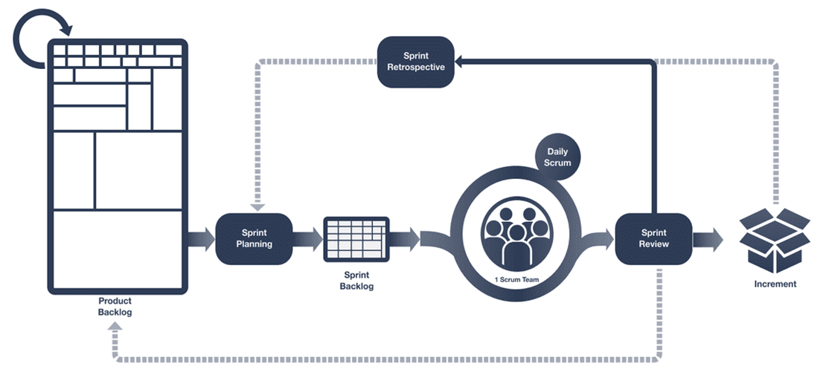
Scrum Workflow
Notes:
Visual Diagram:
"In this diagram, we can see how the Scrum roles, artifacts, and events interact with each other. The iterative nature of Scrum allows teams to continuously refine their work based on feedback and learning from each sprint.“
Key Points:
"The workflow emphasizes collaboration among team members and stakeholders, ensuring that everyone is aligned and working towards the same goals."

Slide 7




Benefits of Scrum
Increased Transparency
Higher Product Quality
Regular meetings and updates keep everyone informed.
01
02
Continuous testing and feedback lead to better outcomes.
03
04
Enhanced Flexibility
Improved Team Collaboration
Ability to adapt to changing requirements and priorities.
Promotes a culture of teamwork and accountability.
Notes:
Increased Transparency:
"Scrum promotes transparency through regular meetings and updates, allowing everyone involved to see progress and understand challenges.“
Higher Product Quality:
"With continuous testing and feedback, Scrum helps teams identify and resolve issues early, leading to higher quality products.“
Enhanced Flexibility:
"Scrum allows teams to adapt to changing requirements quickly, ensuring that the product remains relevant and valuable to users.“
Improved Team Collaboration:
"The emphasis on teamwork and communication fosters a collaborative environment, which can lead to innovative solutions and a more engaged team."

Slide 8



Challenges of Scrum
Role Clarity
Misunderstanding roles can lead to confusion and inefficiencies.
Team Dynamics
Commitment
Requires strong collaboration and communication skills.
Requires full commitment from all team members to be effective.
Notes:
Team Dynamics:
"Effective Scrum implementation requires strong collaboration and communication skills. Teams may face challenges if members are not fully engaged or if there are conflicts.“
Role Clarity:
"Misunderstanding the roles of Product Owner, Scrum Master, and Development Team can lead to confusion and inefficiencies. Clear definitions and responsibilities are essential.“
Commitment:
"Scrum requires full commitment from all team members. If some members are not dedicated to the process, it can hinder the team's success."

Slide 9
Conclusion
Companies like Google, Spotify and IBM using scum framework to enhance their project management process
Tools like Jira, Trello and Asana helps the companies to enhance their process
Scrum is an agile framework that promotes iterative development and collaboration.
Key roles, artifacts, and events are essential for effective implementation
Embracing Scrum can lead to improved project outcomes and a more engaged team.
Notes:
Recap Key Points:
"In summary, Scrum is an Agile framework that promotes iterative development and collaboration among teams. Understanding the key roles, artifacts, and events is essential for effective implementation.“
Final Thought:
"By embracing Scrum, organizations can achieve better project outcomes and foster a more engaged and productive team."

Slide 10


"Thank you for your attention!.”

